Slide 1
ENVIRONMENTAL MONITORING
Noise Pollution Monitor

Slide 2
DOMAIN
This project serves to help to make the library noise-free. Since it uses wireless sensor networking capabilities to interact with the building and automate a task, we think it justifies the `Smart Buildings` category.

Slide 3
OBJECTIVE
The objective of this project is to actively monitor noise level inside the library. We are using a Sound Sensor with ESP8266 (Wifi Module) to monitor noise levels in the library. We aggregate the sensor data every 15 seconds and if it crosses the threshold level, we trigger an SMS to the guard's mobile phone present in the library.

Slide 4
Realtime Application
We have made our project as a real word application which can be used on our university's campus. Apart from this, this project can be used in areas like schools, hospitals and other buildings where silence has to be maintained.
Multiple arduino boards can be set up in the building where each can measure the noise levels and notify the nearest concerned authority.

Slide 5
Hardware Used
| Components | Units |
|:-----------------:|:-------------:|
|Arduino UNO | 1 |
|ESP8266 Wifi Module| 1 |
|Analog Sound Sensor| 1 |
|Breadboard | 1 |
|Jumper Wires | 15 |
|___________________|_______________|

Slide 6
#include <SoftwareSerial.h>
#define DELAY_PERIOD 16000
#define SSID "geek8“
#define PASS "123kkaabb“
#define PUBLIC_KEY "q5JMKnDJKXCMnjbYr0lG“
#define PRIVATE_KEY "BVBdMRDBMAt60G1J8WV5“
#define DEBUG 0char serialbuffer[100];
long nextTime;int wifiConnected = 0;
SoftwareSerial mySerial(10,11);
void setup(){ mySerial.begin(9600);
Serial.begin(9600);
if(DEBUG) {
while(!Serial);
}
delay(1000);
mySerial.println("AT+RST");
delay(3000);//delay after mode change mySerial.println("AT+CWMODE=1");
delay(300); mySerial.println("AT+RST");
delay(500); nextTime = millis();//reset the timer
}
boolean connectWifi()
{
String cmd="AT+CWJAP=\""; cmd+=SSID; cmd+="\",\""; cmd+=PASS; cmd+="\""; Serial.println(cmd); mySerial.println(cmd);
for(int i = 0; i < 20; i++)
{
Serial.print(".");
if(mySerial.find("OK"))
{
wifiConnected = 1;
break; }
delay(50); }
Serial.println( wifiConnected ? "OK, Connected to WiFi." : "Can not connect to the WiFi." );
return wifiConnected;}

Slide 7
void loop()
{
if(!wifiConnected) {
mySerial.println("AT");
delay(1000);
if(mySerial.find("OK")){
Serial.println("Module Test: OK");
connectWifi(); } }
if(!wifiConnected) {
delay(500);
return; }
while (mySerial.available() > 0) {
Serial.write(mySerial.read()); }
if (Serial.available() > 0) {
int len = Serial.readBytesUntil('\n', serialbuffer, sizeof(serialbuffer));
String message = String(serialbuffer).substring(0,len-1); Serial.println("message: " + message");
if(message.substring(0,2)=="AT"){
Serial.println("COMMAND REQUEST");
mySerial.println(message);
}
}
if(nextTime<millis()){ Serial.print("timer reset: ");
Serial.println(nextTime);
nextTime = millis() + DELAY_PERIOD;
int val = 0; for(int i = 0; i < 10; i++) {
val += analogRead(0); delay(1500); }
SendTempData(val);
}
}

Slide 8
void SendTempData(int temperature){
char temp[10];
Serial.print("loudness val: ");
Serial.println(temperature);
dtostrf(temperature,1,2,temp);
String startcommand "AT+CIPSTART=\"TCP\",\"data.sparkfun.com\", 80"; mySerial.println(startcommand);
Serial.println(startcommand);
if(mySerial.find("Error")){
Serial.println("error on start");
return;
}
String sendcommand = "GET /input/"; sendcommand.concat(PUBLIC_KEY); sendcommand.concat("?private_key=");
sendcommand.concat(PRIVATE_KEY);
sendcommand.concat("&temp=");
sendcommand.concat(String(temp));
sendcommand.concat("\r\n");
//sendcommand.concat(" HTTP/1.0\r\n\r\n");
Serial.println(sendcommand); mySerial.print("AT+CIPSEND="); mySerial.println(sendcommand.length());
Serial.print("AT+CIPSEND=");
Serial.println(sendcommand.length());
if(mySerial.find(">")) { Serial.println(">");
}
else {
mySerial.println("AT+CIPCLOSE");
Serial.println("connect timeout");
delay(1000); return; }
//Serial.print("Debug:");
//Serial.print(sendcommand); mySerial.print(sendcommand);
delay(1000);
mySerial.println("AT+CIPCLOSE");}

Slide 9
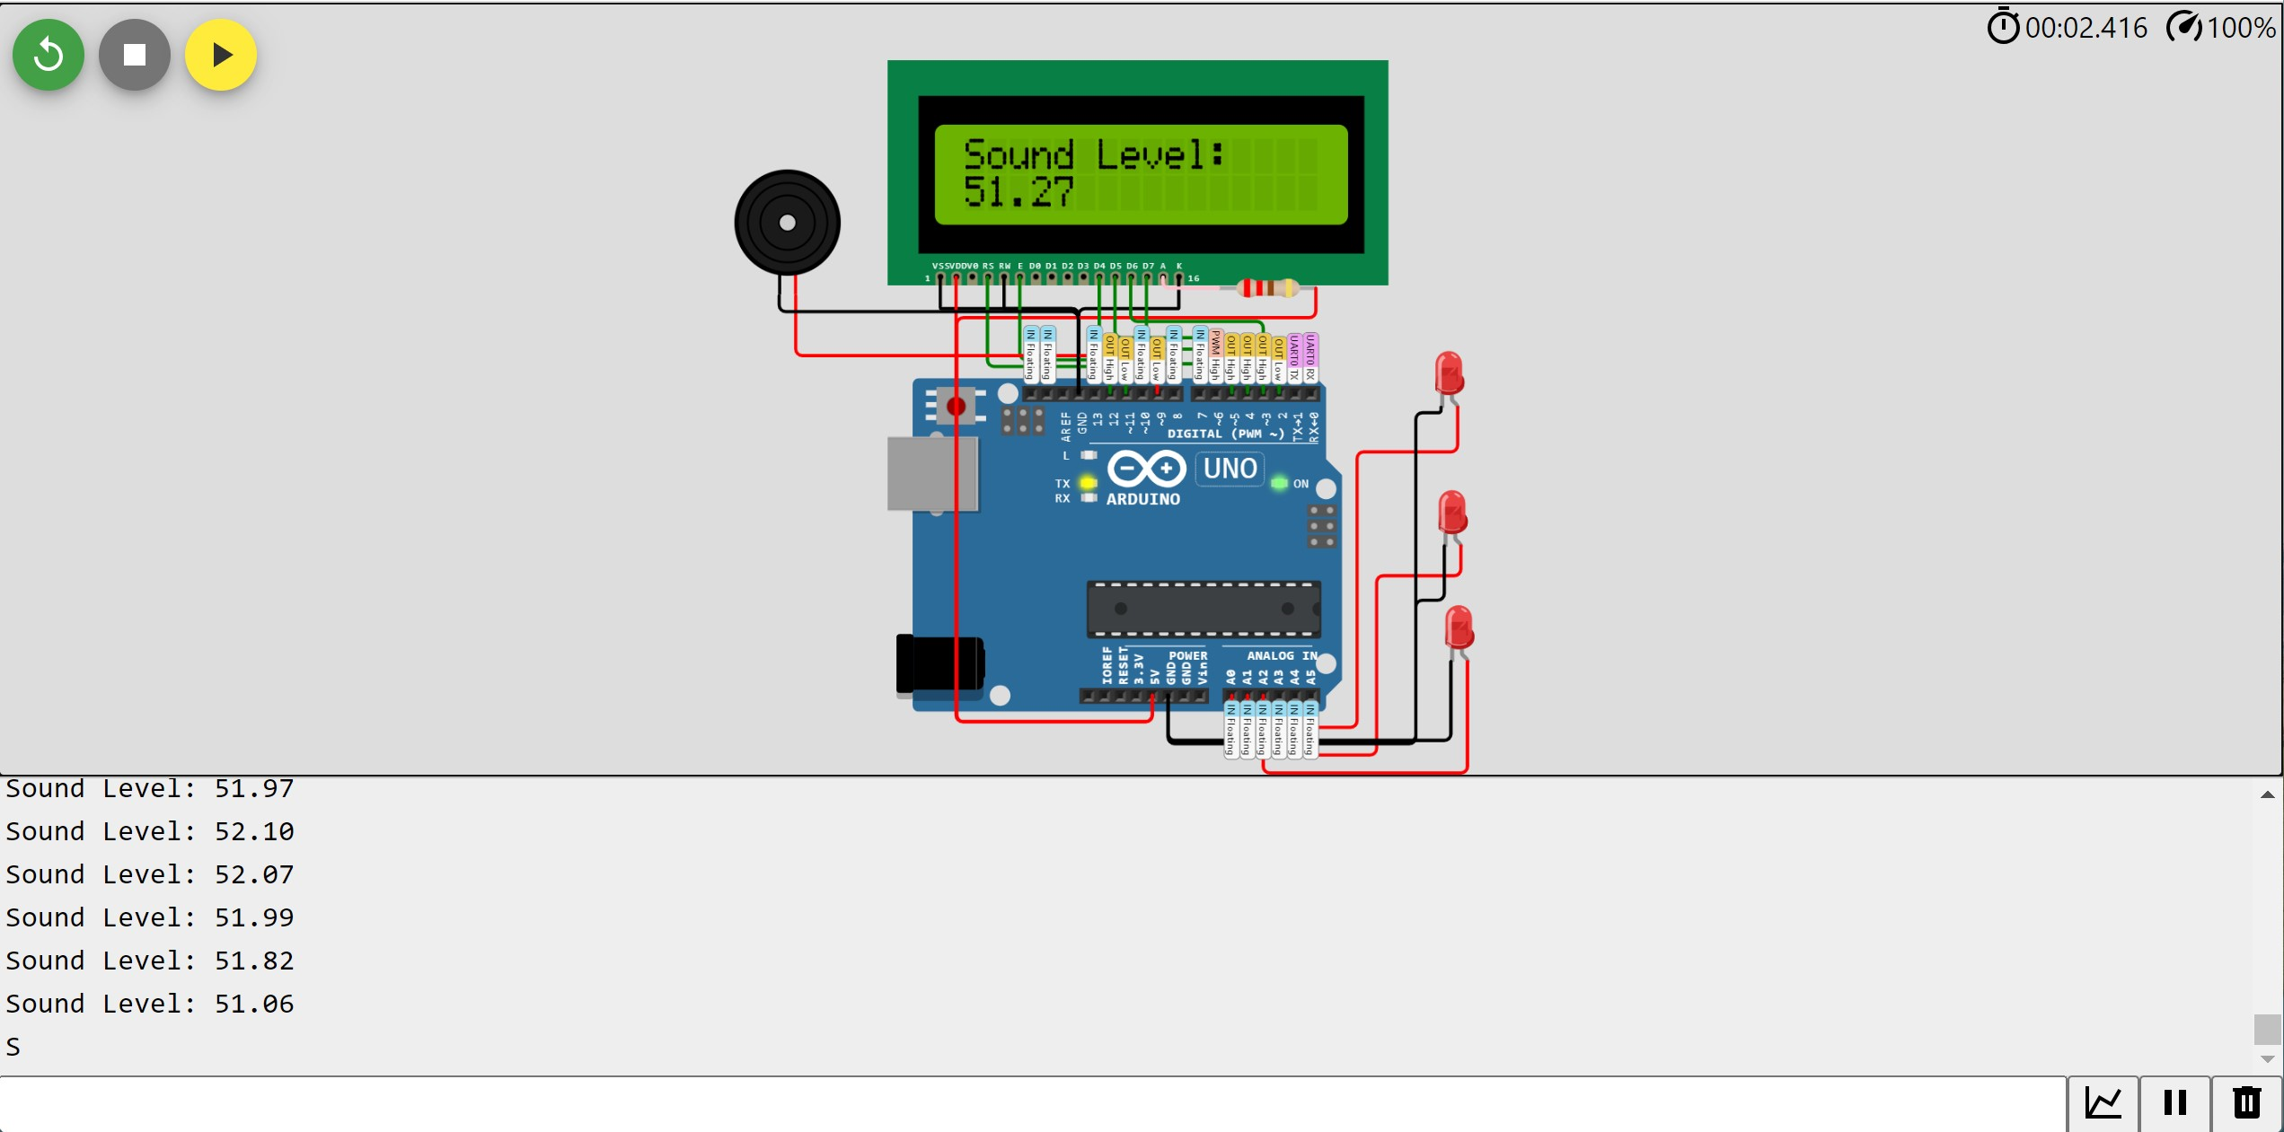
Output

Slide 10
Thank You!!

